Slide 1

PeachTree

Slide 2
About us
Notes:
Introduce ourselves
Natasha - Talk about previous websites created, what they achieved and any issues we had
Hennah – Unique selling point
Joe - Talk about how we incorporate many new agile techniques to improve security
Anisa – Mention Analytics
Transition – ‘So lets talk about what we’ve been doing recently’

Slide 3
About the project
Notes:
What is the University Magazine Contribution website?
Explain the problem (need students to contribute)
Explain how the system would be implemented (use existing university email addresses and pwds)
What does the system do?
Go through use case for each type of user
Transition – ‘Lets look at some examples of the system in action’

Slide 4
Guest experience
Notes:
This experience is for people who may not belong to any faculty in the university, but are interested in viewing past publications of the magazine.

Slide 5
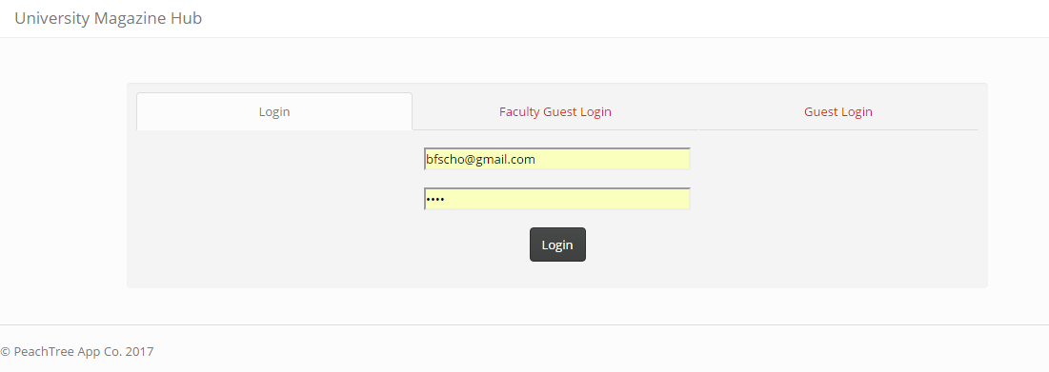
Login

Slide 6
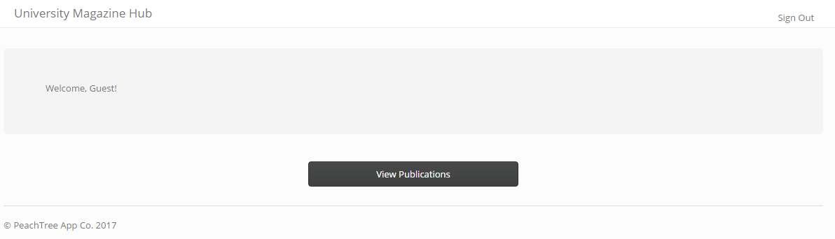
Home

Slide 7
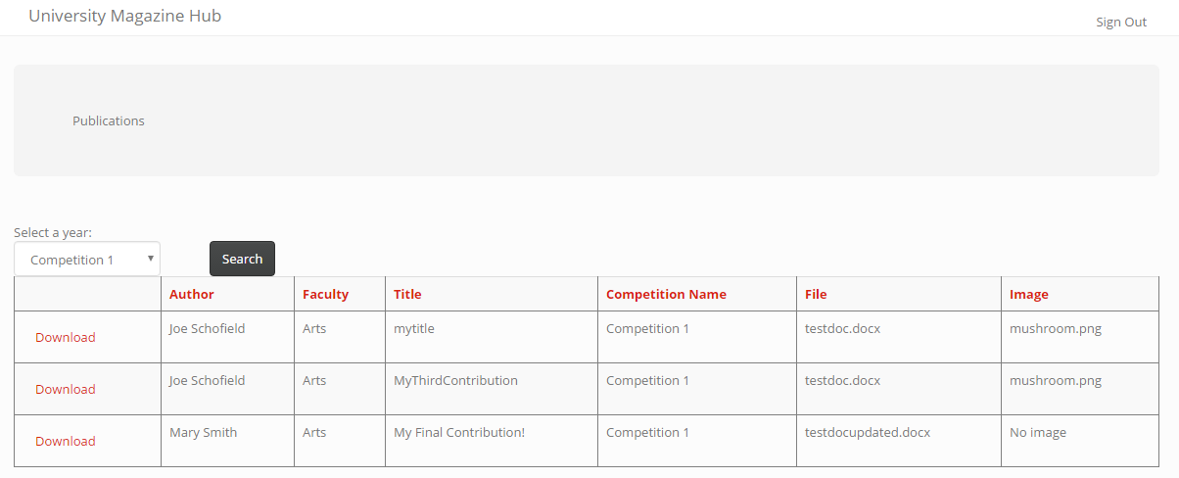
Publications

Slide 8
Faculty guest experience

Slide 9
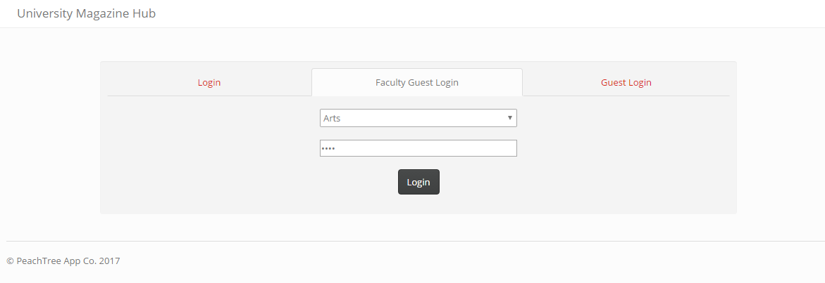
Login

Slide 10
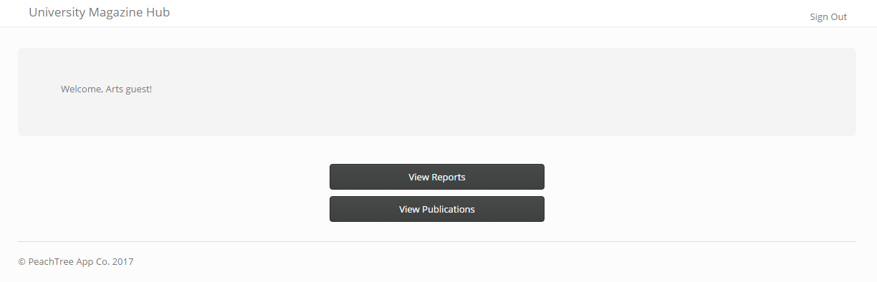
Home

Slide 11
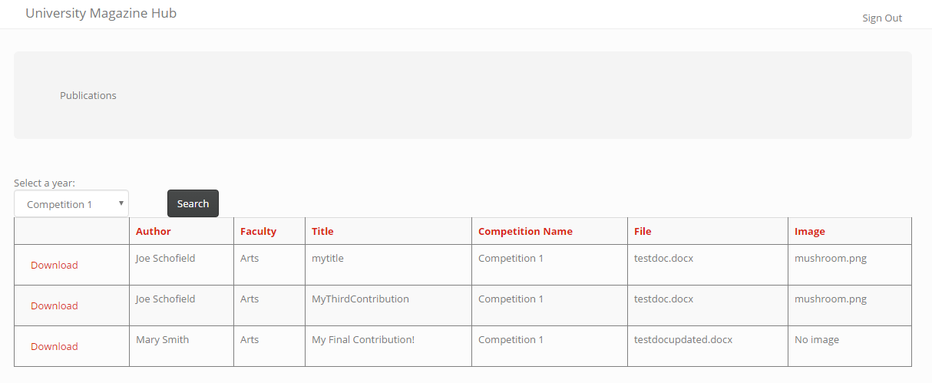
Publications

Slide 12
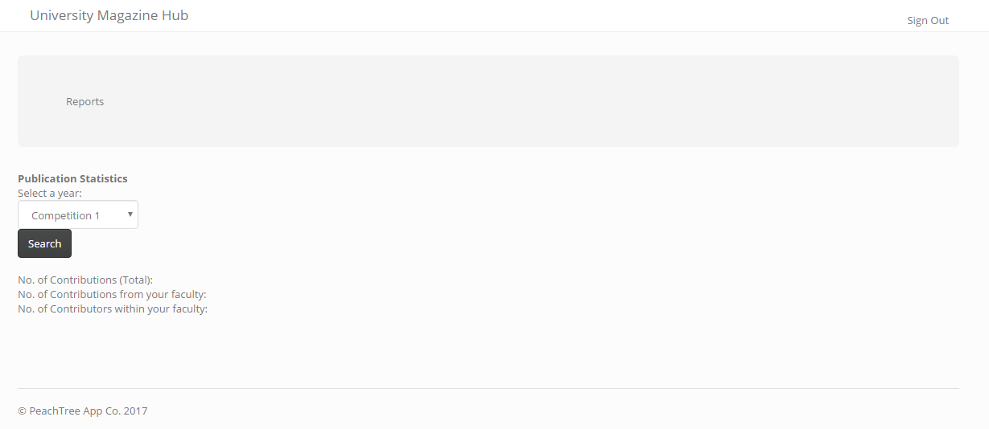
Reports

Slide 13
Student experience

Slide 14
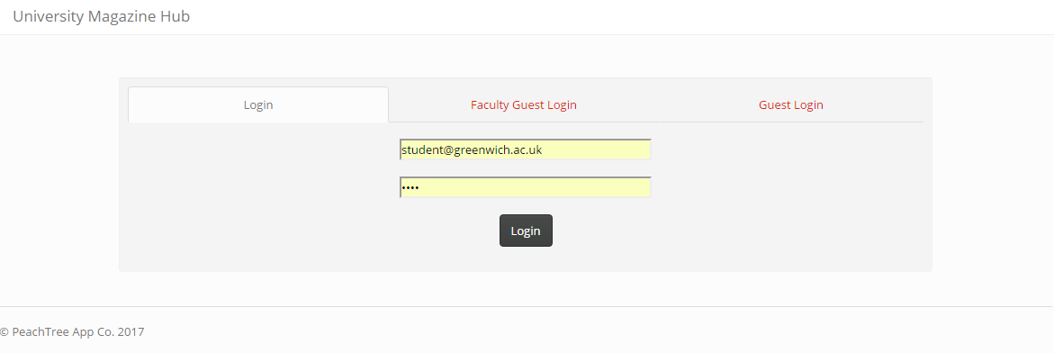
Login

Slide 15
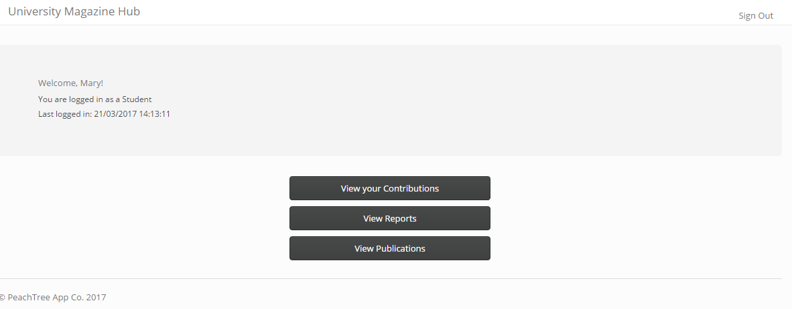
Home

Slide 16
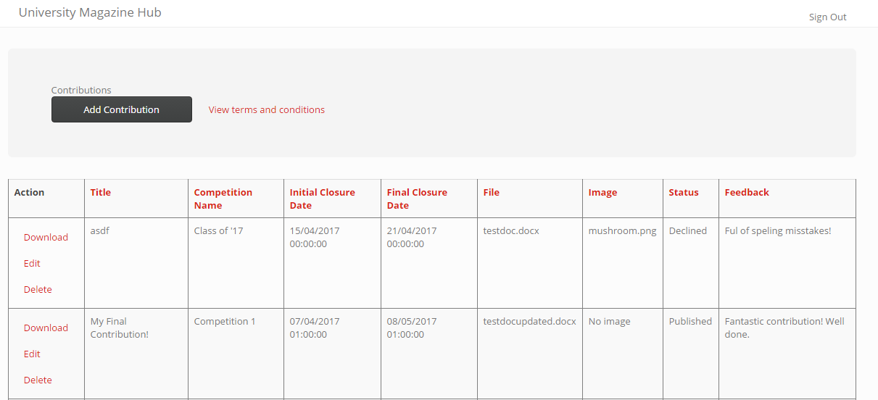
Contributing

Slide 17
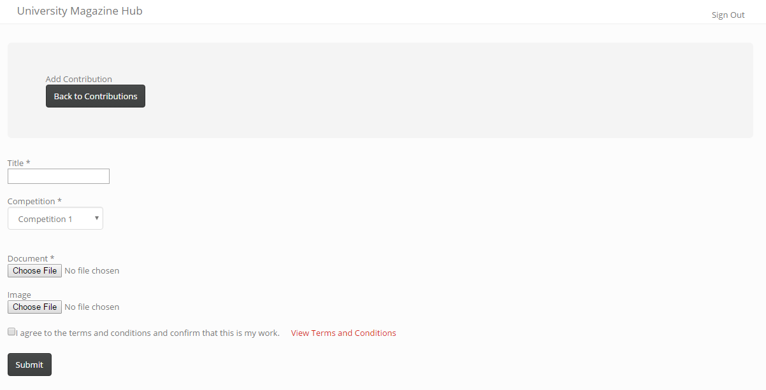
Contributing

Slide 18
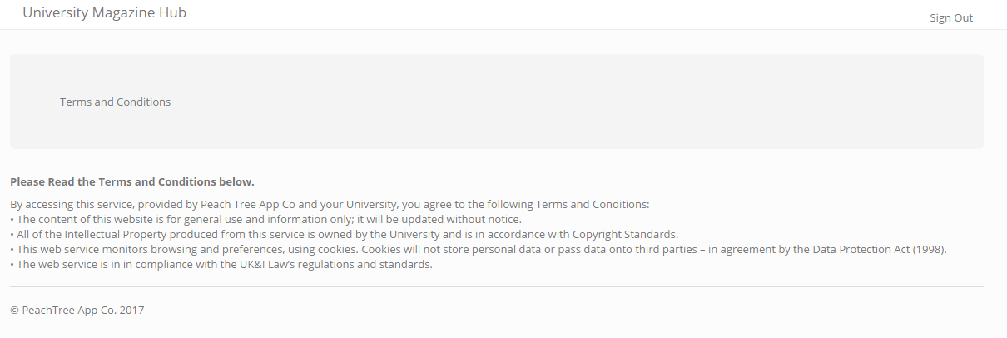
T’s & C’s

Slide 19

Reports

Slide 20
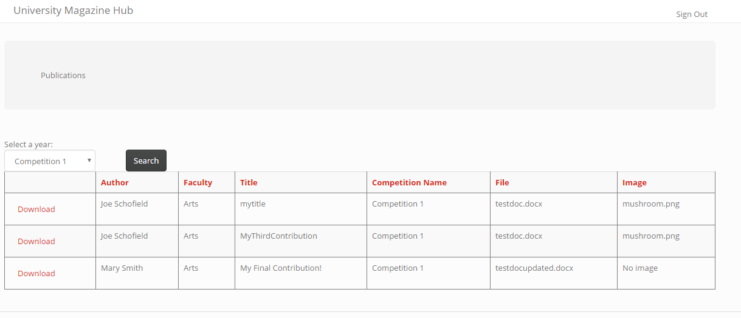
Publications

Slide 21
Marketing Coordinator
experience

Slide 22
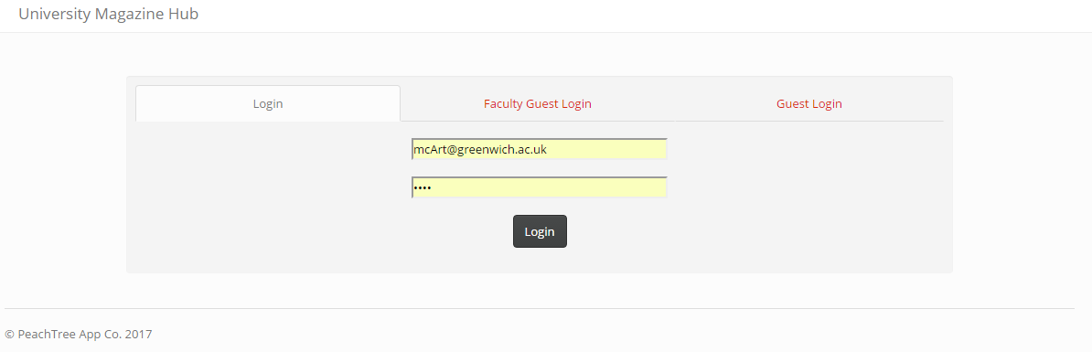
Login

Slide 23
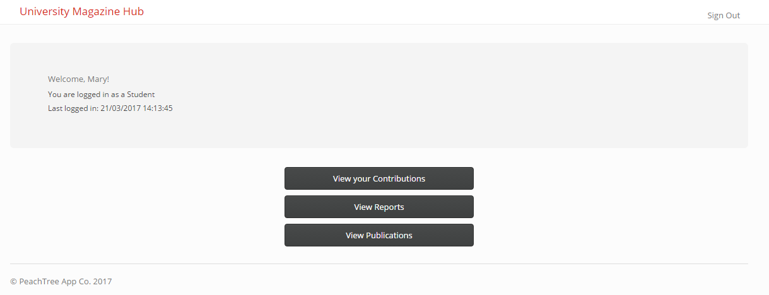
Home

Slide 24
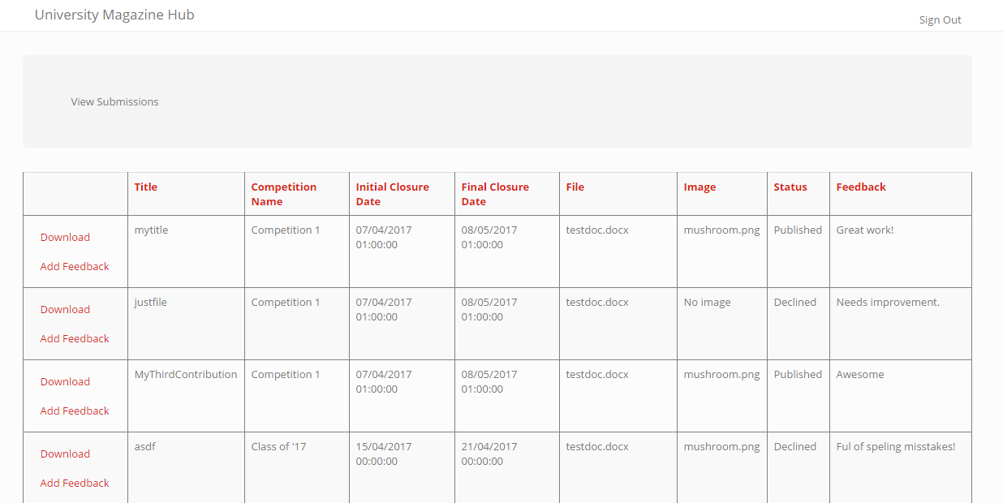
Submissions

Slide 25
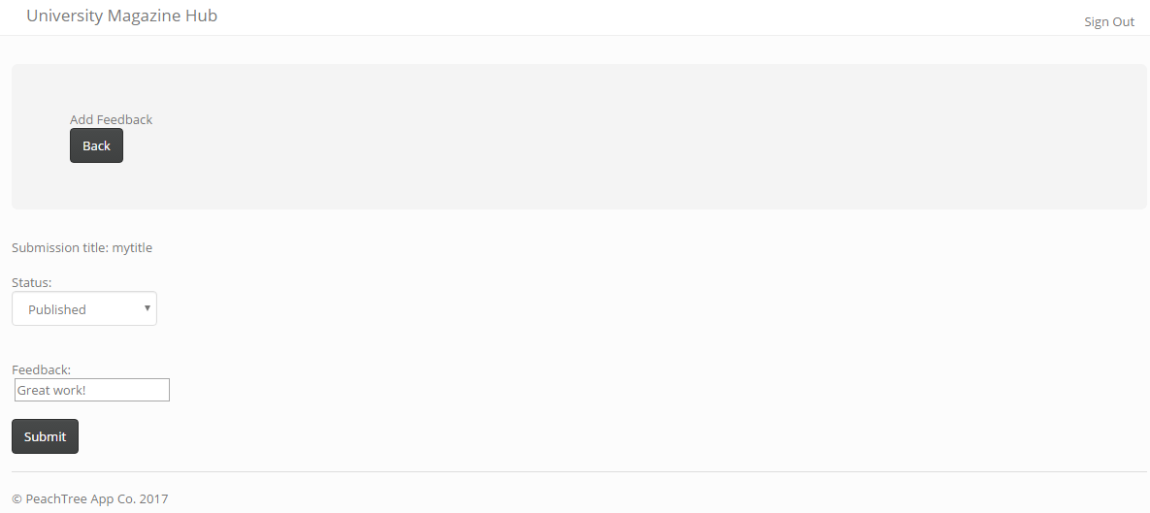
Feedback

Slide 26
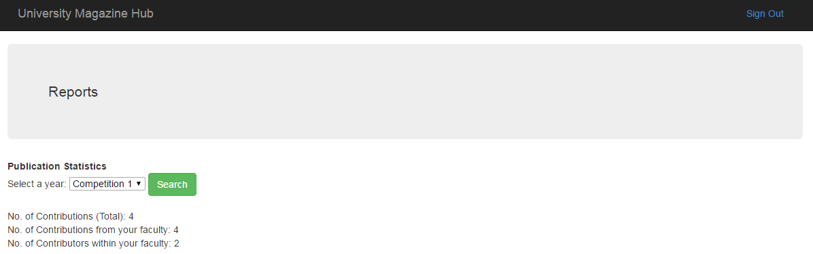
Reports

Slide 27
Publications

Slide 28
Marketing Manager
experience

Slide 29
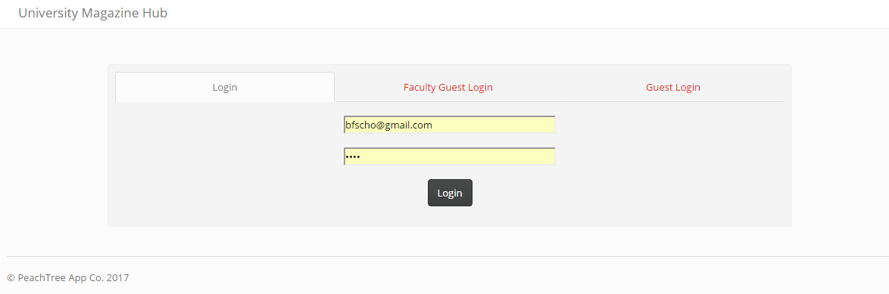
Login

Slide 30
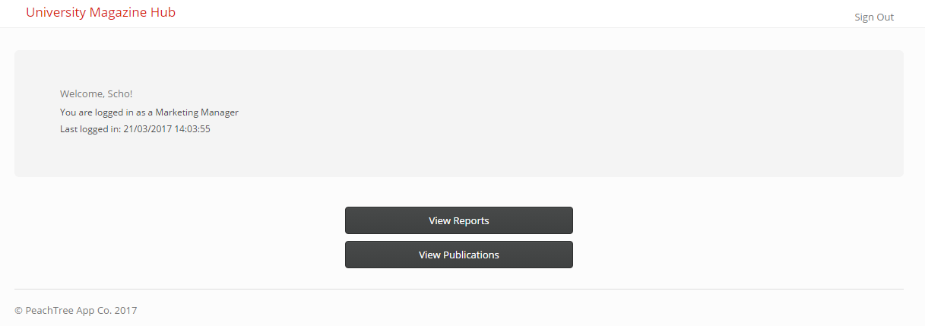
Home

Slide 31
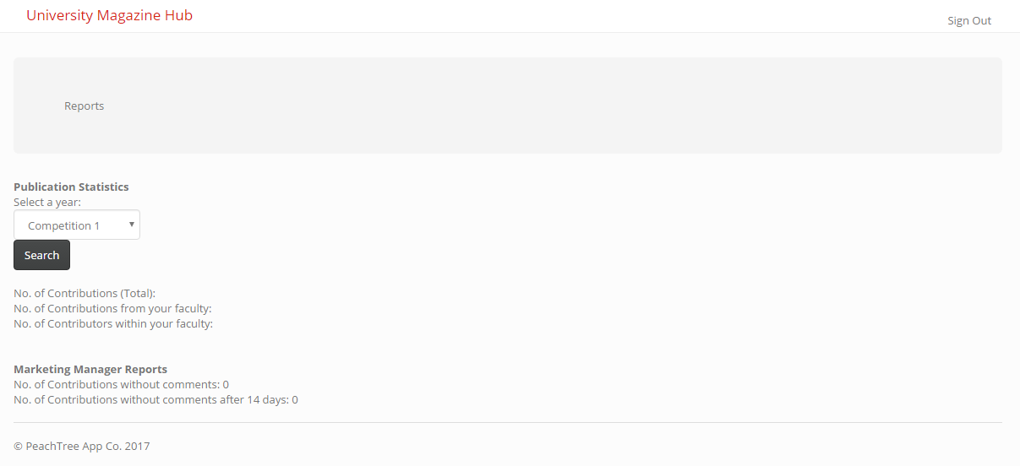
Reports

Slide 32
Publications

Slide 33
Administrator experience

Slide 34
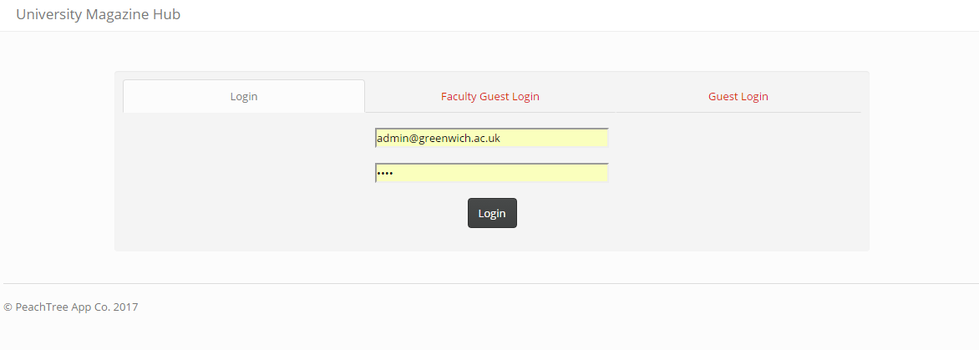
Login

Slide 35
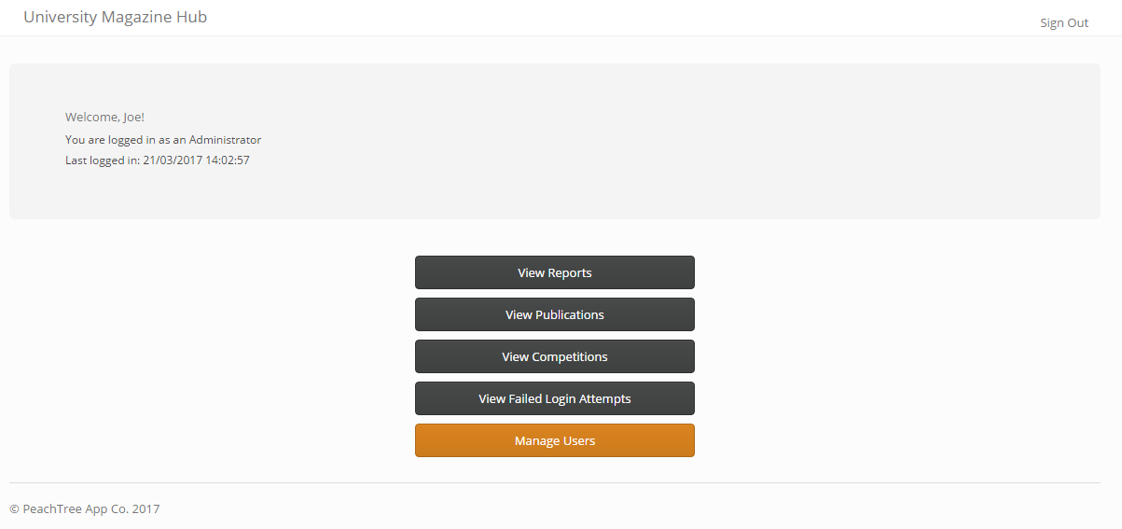
Home

Slide 36
Reports

Slide 37
Publications

Slide 38
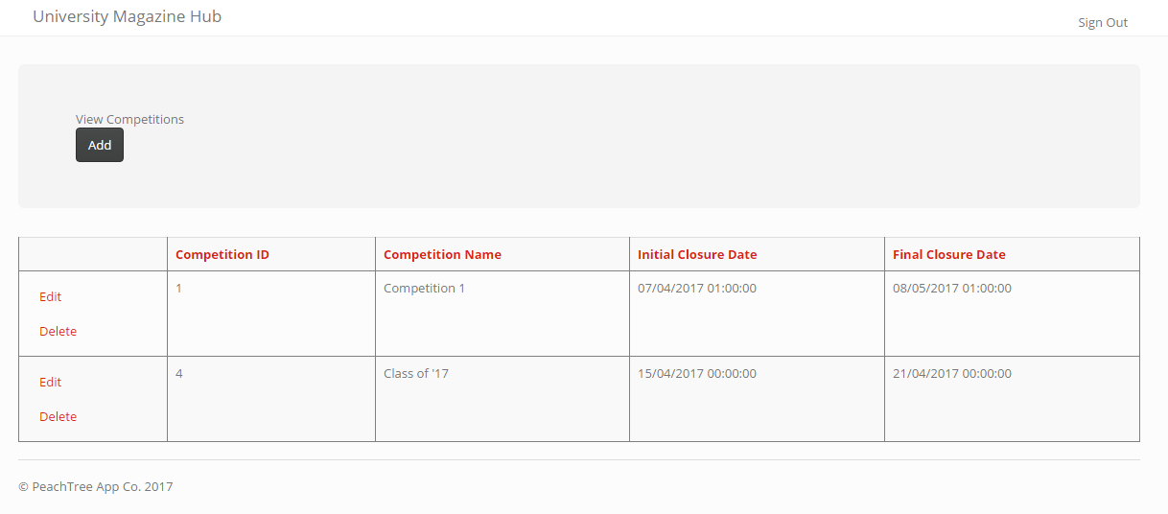
Competitions

Slide 39
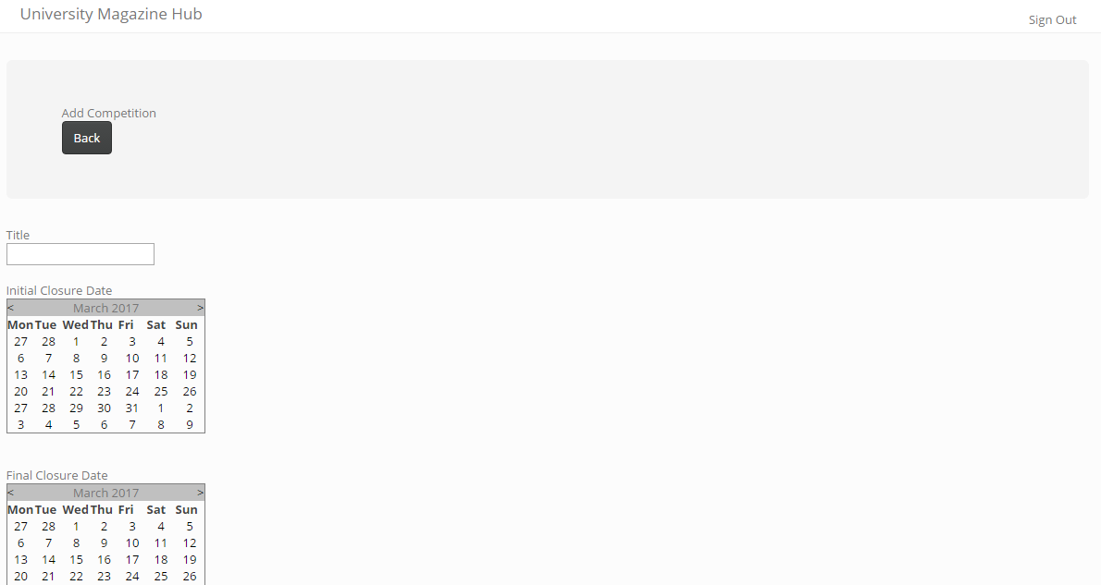
Competitions

Slide 40
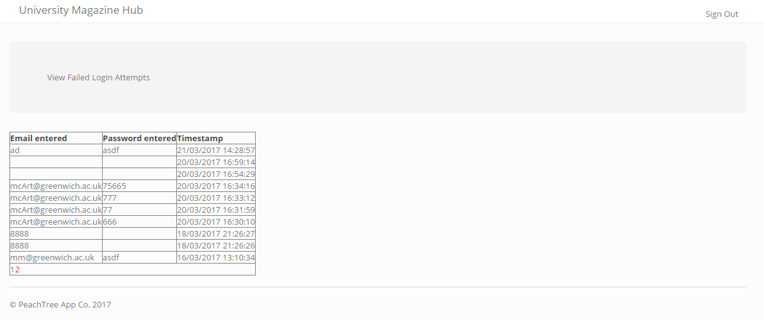
Failed Login Attempts

Slide 41
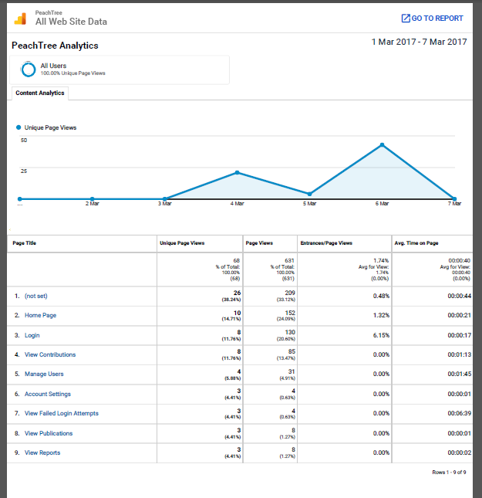
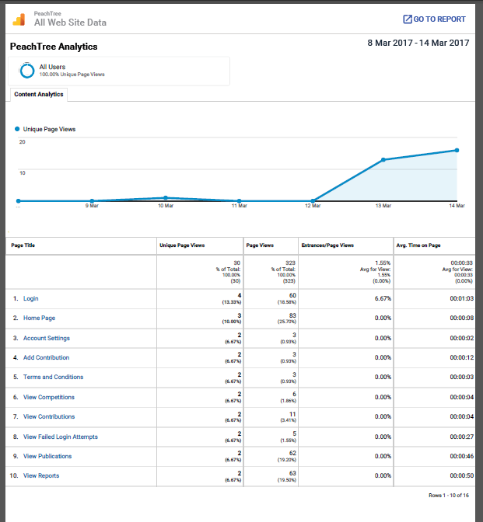
Analytics

Slide 42
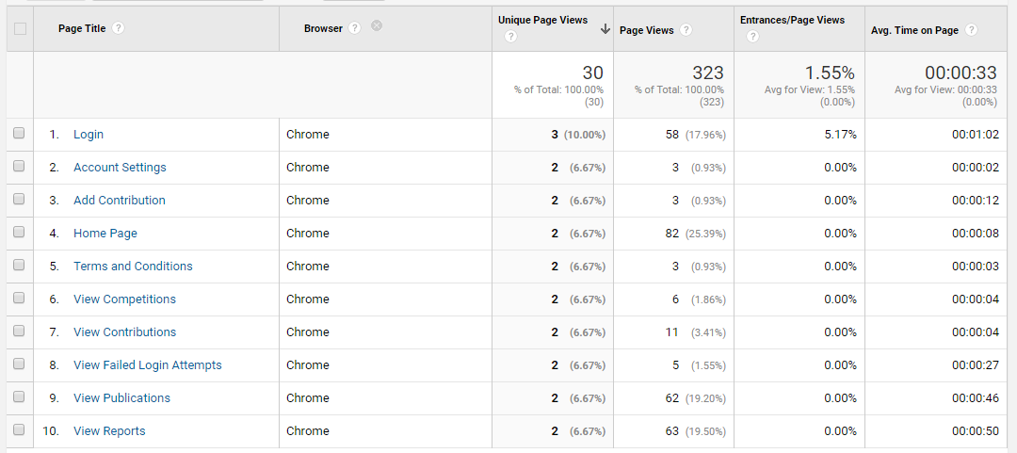
Analytics

Slide 43
Future
Notes:
Mention how in the future we will improve:
UI
Add more functionality to:
Manage users
Fine tune analytics to see more valuable results
Graphical representations of reports
Download images
Download all reports from closed competitions in a zip for marketing manager

Slide 44
Questions

